Slide 1
5 Paragraph Essay Review

Slide 2
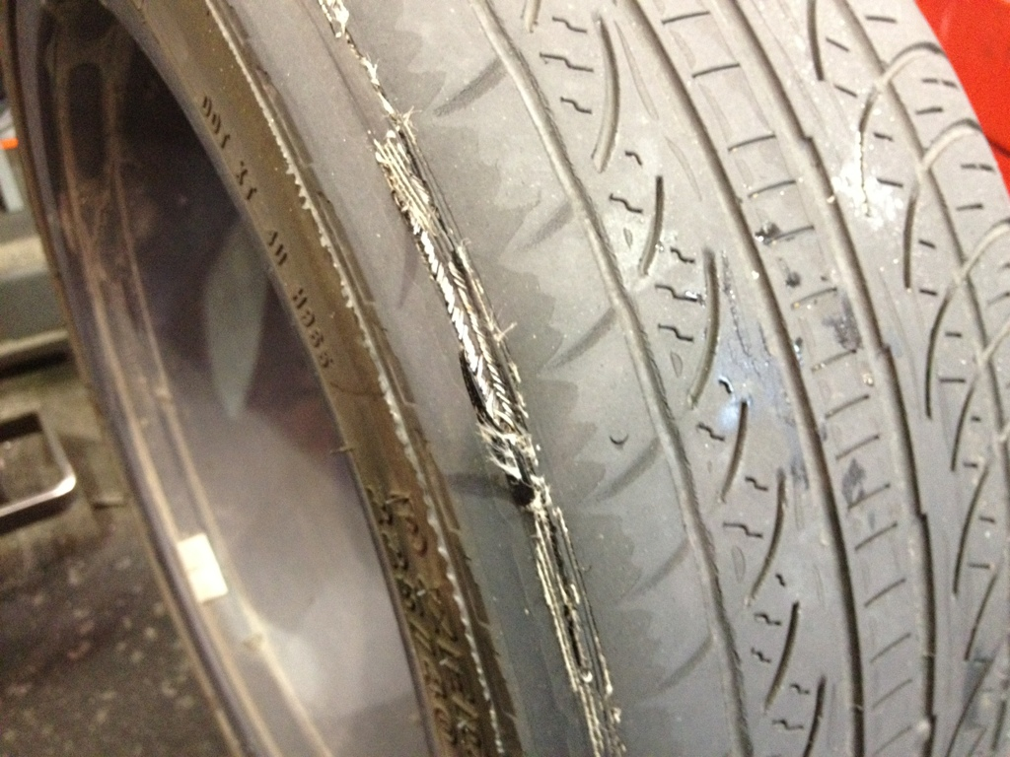

Slide 4
Introduction Paragraph
Grabber
Why did we go to war for a state we didn’t even want?
In 1846, the United States went to war with Mexico only 20 years after it had gained independence from Spain. The territory between the Nueces and the Rio Grande River had become disputed territory.
Was the United States justified in going to war? In other words, did the United States have a good enough reason?
The United States was unjustified with going to war with Mexico because, one they took Mexico’s land, two they went up to the border, and three, they disobeyed Mexico’s laws.
Background
Restate the Question
Thesis Statement

Slide 5
1st Paragraph
Baby Thesis Statement
The United States was unjustified in going to war with Mexico because they took Mexico’s land.
After U.S. settlers chose not to follow the rule of no slavery, Texas won its independence from Mexico in 1836(Doc D).
Mexico might have invited Americans to live in Texas but that did not make it right for the U.S. to take the land
Evidence
Argument

Slide 6
2nd Paragraph
Transition
At the same time,
the United States was also unjustified for going up to the Mexican border.
Mexico refers this to the “U.S invasion” simply because the United states went up to the Mexican border and in the Mexicans eyes the U.S was on the rage to attack (Doc C).
Since the Mexicans thought that the United States was ready to attack, Mexico believed that they need to protect themselves, so they decided to fight back toward the U.S in self defense.

Slide 7
3rd Paragraph
Further more, the United States was unjustified in going to war with Mexico because the U.S disobeyed Mexico’s slavery laws. The United States began to cross the Sabine River with their slaves, in defiance of the Mexican ordinance of freedom (Doc D). Although the United States knew that Mexico had a strict law on no slaves, the U.S did it any ways and that was not right or fair for Mexico.

Slide 8
Conclusion
Restate the Thesis
In conclusion, the United states was unjustified in going to war with Mexico because the United states broke Mexico’s laws, took land, and went up to the border of Mexico.
Although Mexico did murder 350 Americans in Texas and that angered the American settlers,
this event was not enough reason to take land from another country.
The history of this event is important to this day because the United States and Mexico still border each other and have to work together to solve problems without going to war.

